Slide 1
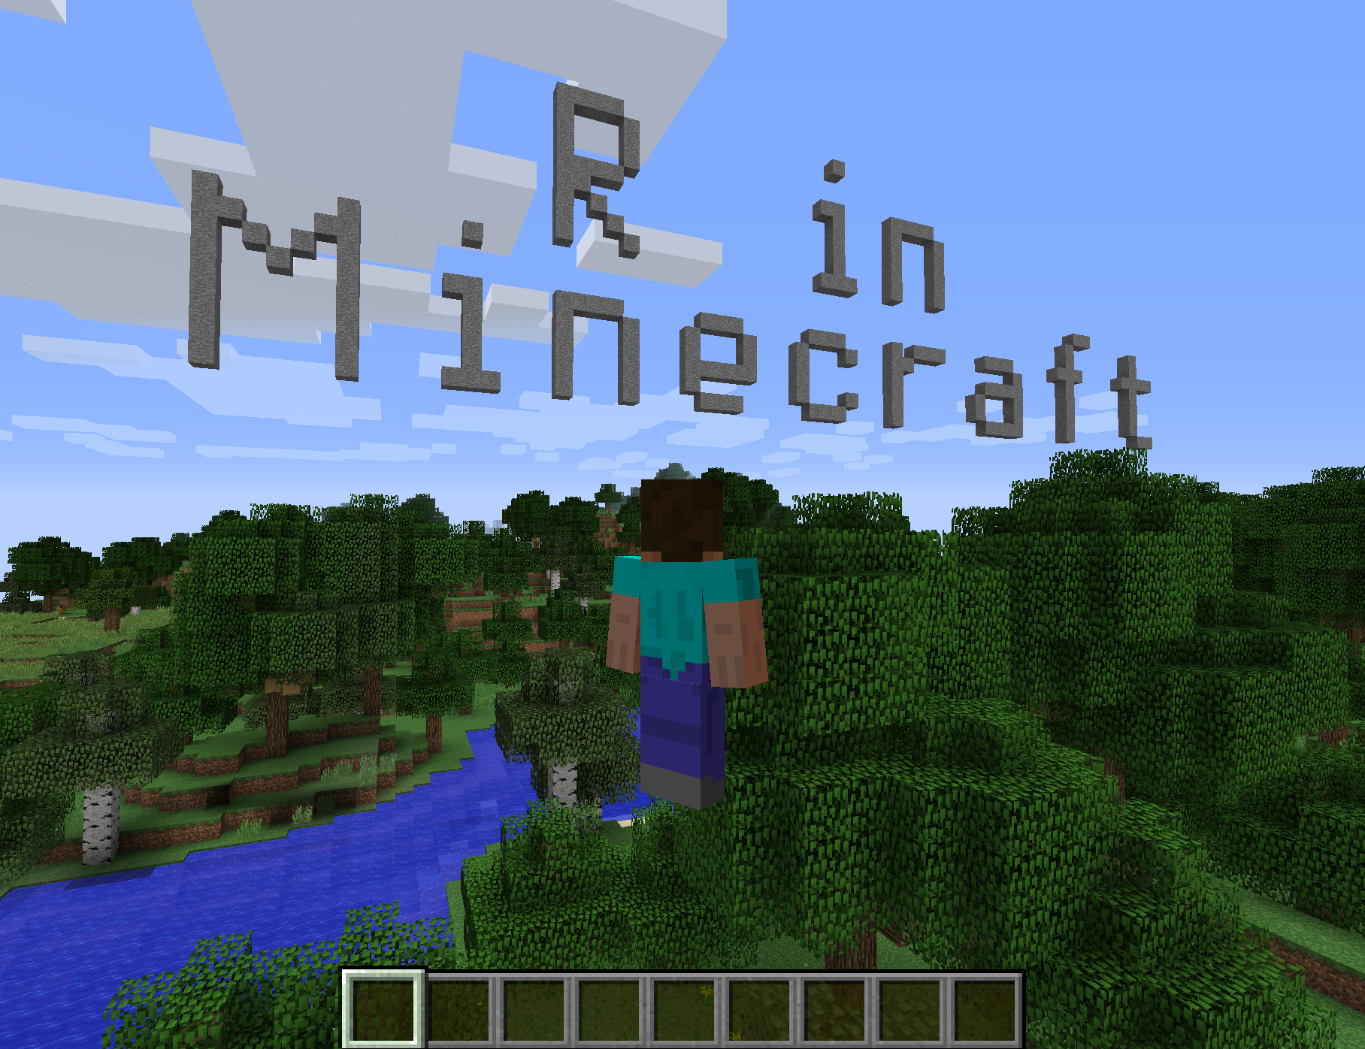
David Smith
@revodavid

Slide 2
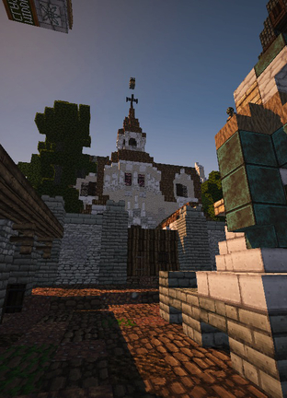
What is Minecraft?
A 3-D exploration and building game
In “Survival” mode, the player crafts resources while defending against monster attacks
In “Creative” mode, it’s more like an immersive virtual Lego session
Developed by Mojang
Acquired by Microsoft in 2014
Hugely popular with under-15s
Notes:
Image source: https://minecraft.net/en-us/article/five-years-westeros

Slide 3
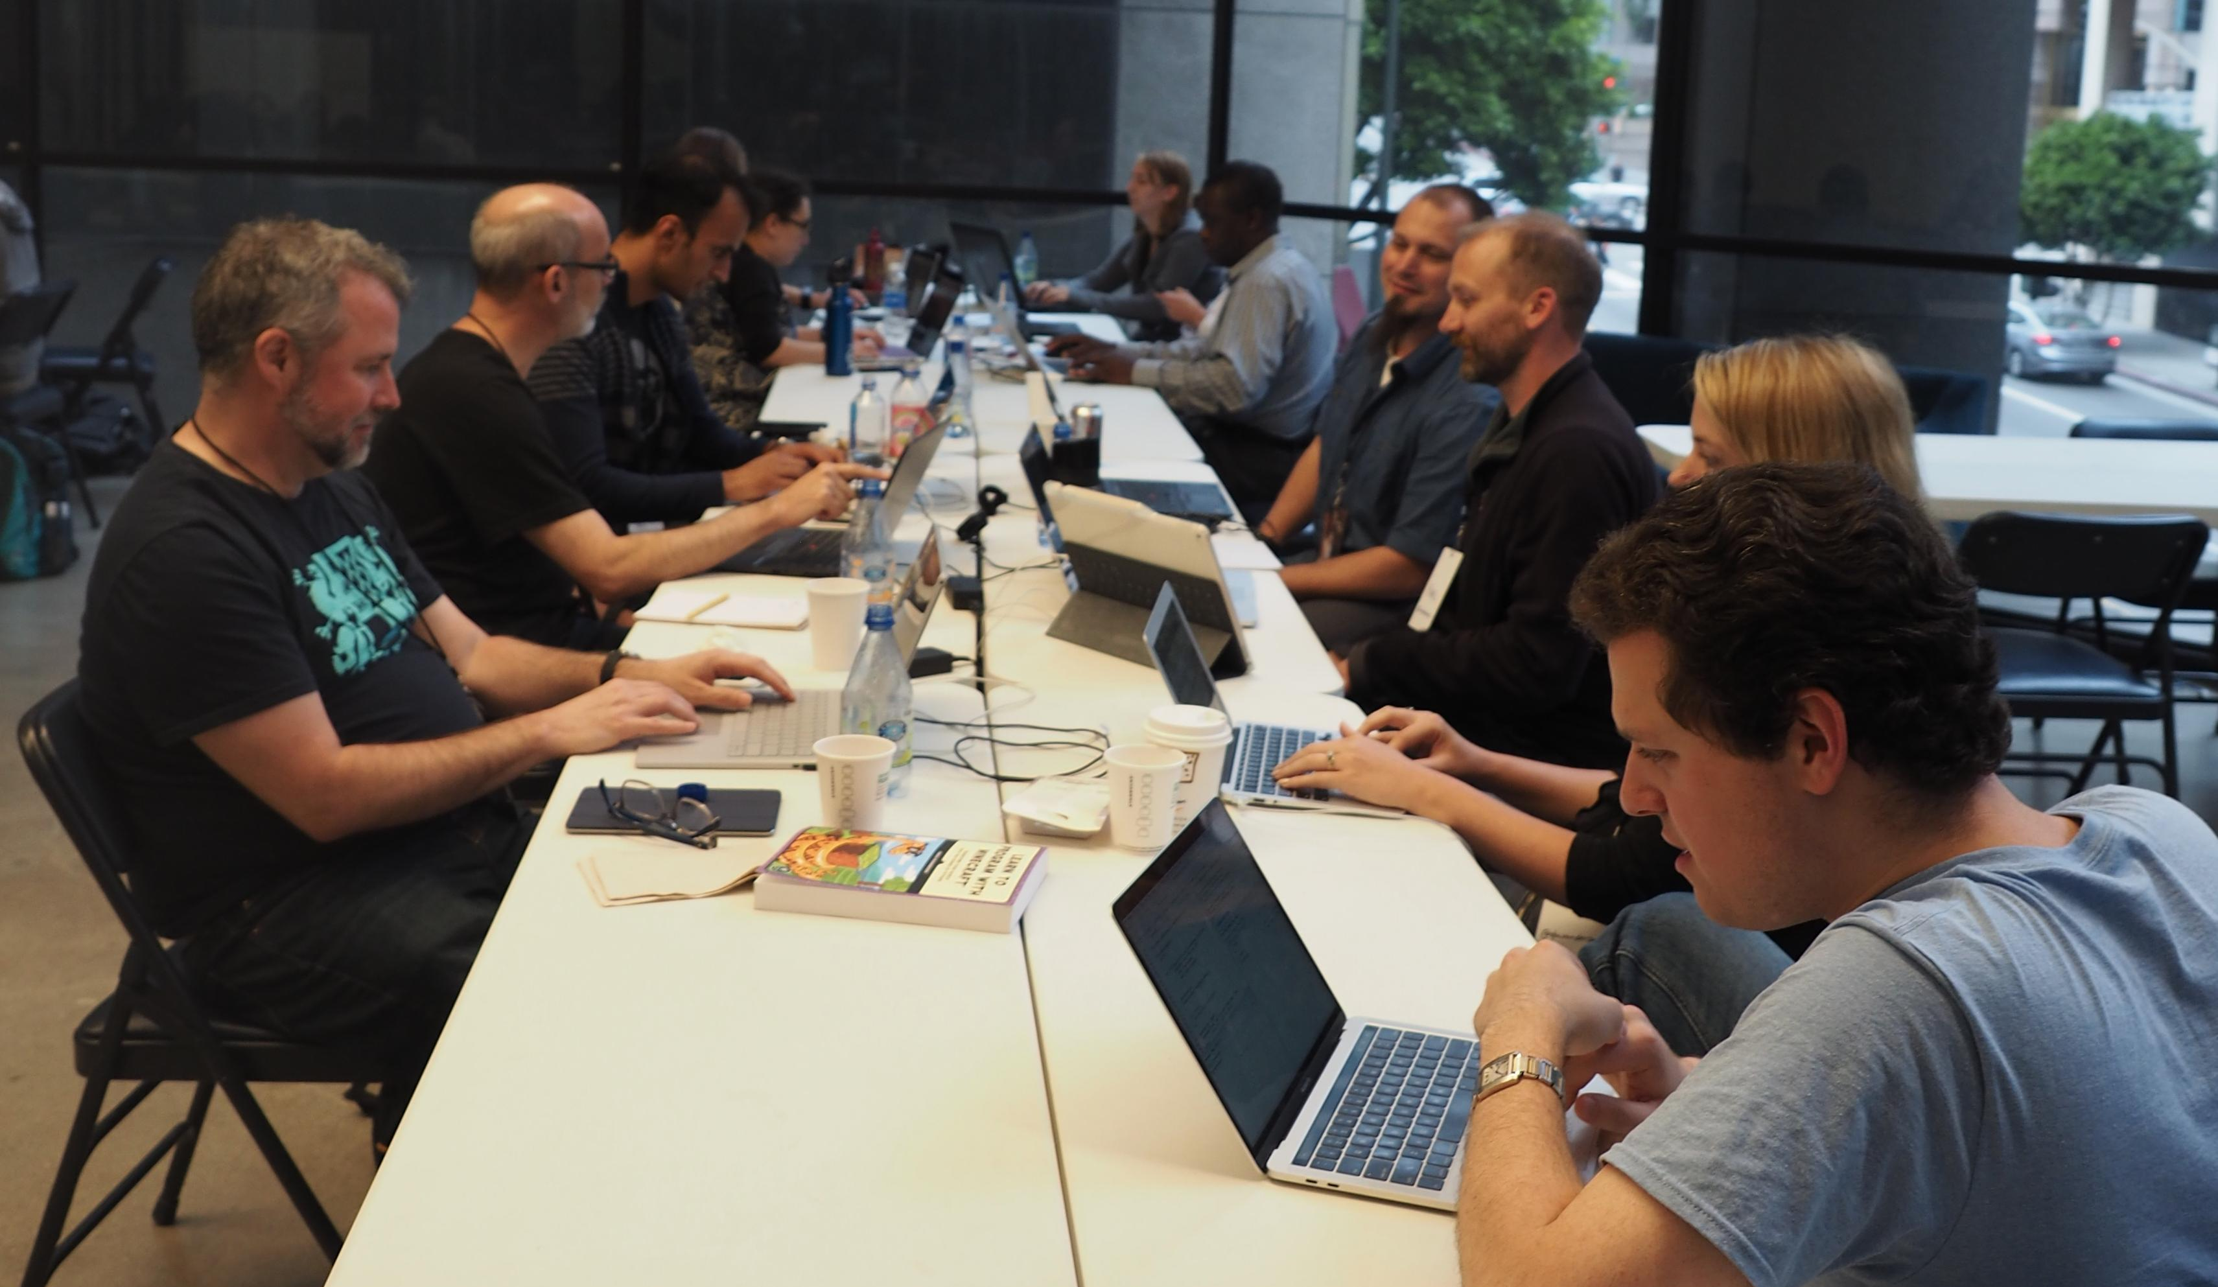

Slide 4
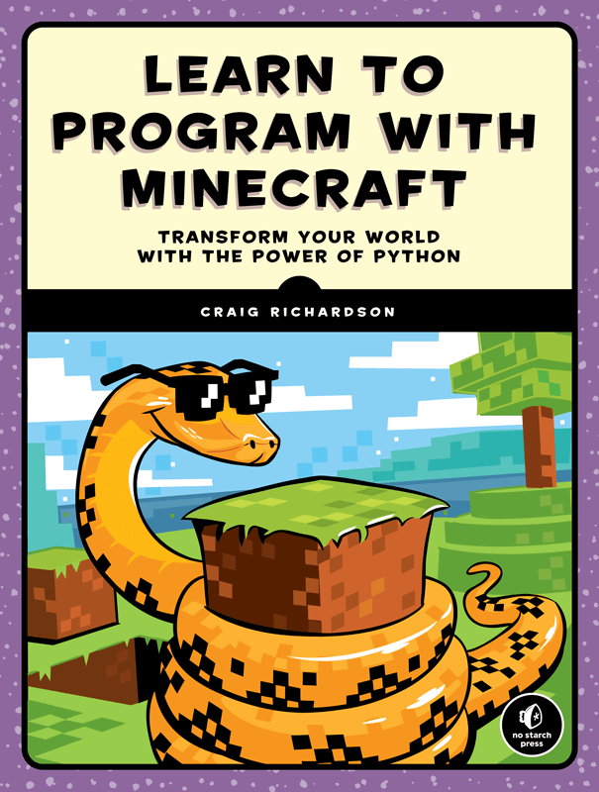
Why R in Minecraft?
Teach kids the R language
motivated by automating tedious tasks in Minecraft
Extensible Client/Server architecture
World can be modified via server extensions
Language API provides a higher-level interface

Slide 5

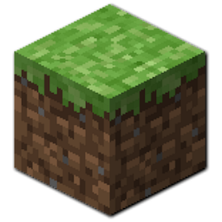

You Will Need:
Minecraft desktop (requires purchase)
Java version NOT Windows Store or Xbox/Mobile version
Minecraft account (account.mojang.com)
Spigot Minecraft server (free)
w/ RaspberryJuice plugin
Desktop client running R
“miner” and “craft” packages

Slide 6
R packages
miner: Basic functions for interfacing with a Minecraft server:
connect to Spigot server
inspect / modify world area (by blocks)
monitor player actions (movement, block interaction)
github.com/ropenscilabs/miner
craft: Higher-level functions built on basic tools
Render a message / image / maze in the world
github.com/ropenscilabs/craft
Accompanying book: ropenscilabs.github.io/miner_book

Slide 7
DIY Docker build with VM in Azure
Launch Ubuntu Data Science Virtual Machine
open ports 4711,25565 in/out (in Networking)
git clone https://github.com/ropenscilabs/miner
cd miner/inst
docker build -t minecraft .
docker run -ti --rm -p 4711:4711 -p 25565:25565 minecraft
> defaultmode creative
> op [your_username]

Slide 8
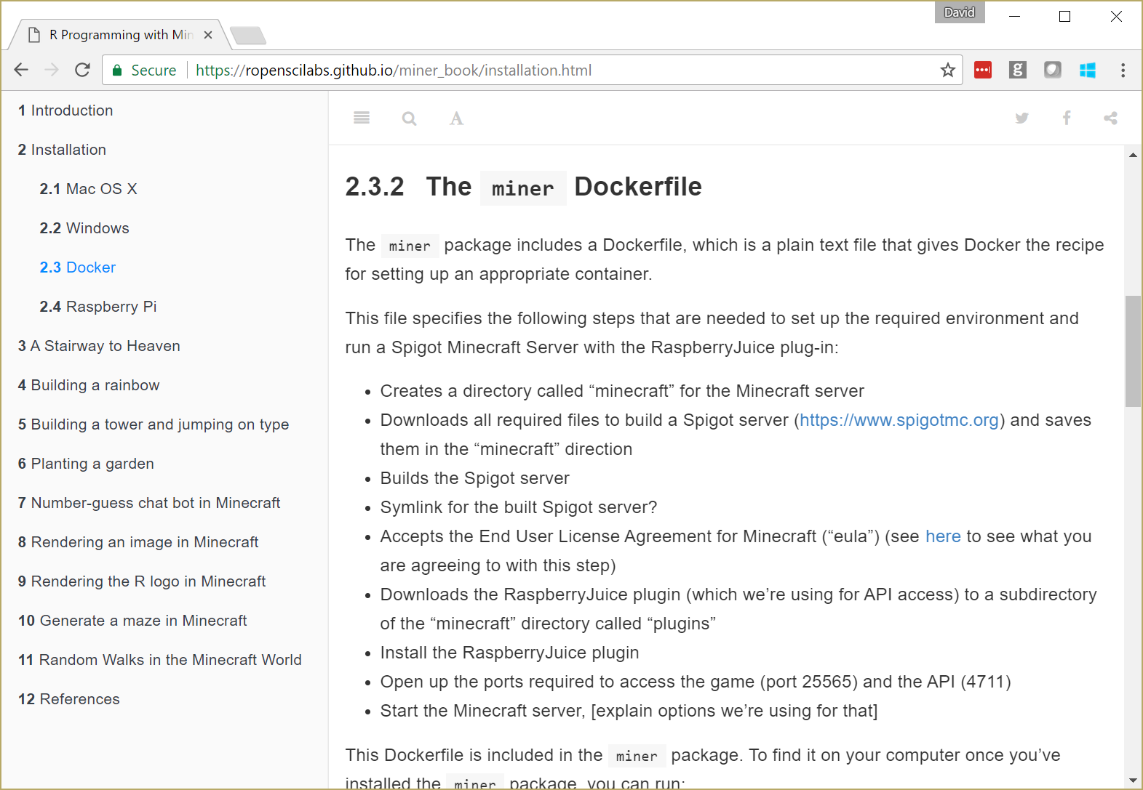

Slide 9
Docker pull
In any Ubuntu docker machine or VM
(still need to open ports 4711,25565 in/out)
sudo docker run -ti --rm -p 4711:4711 -p 25565:25565 \ revodavid/minerserver:latest

Slide 10
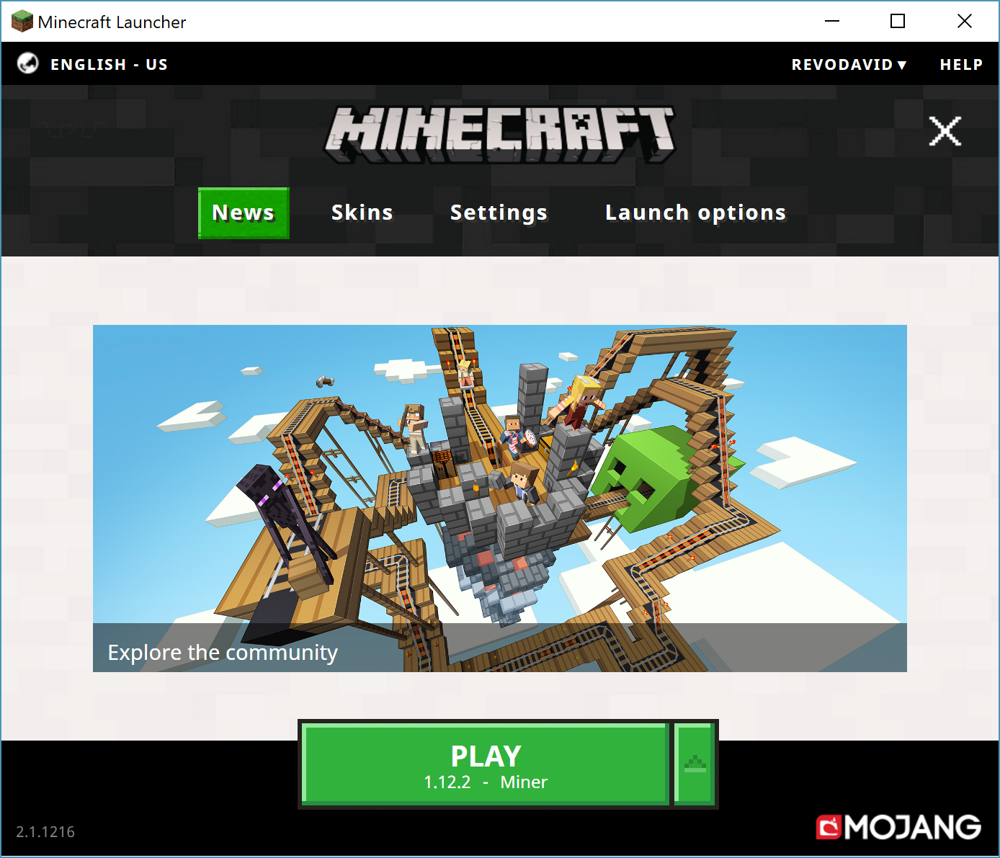
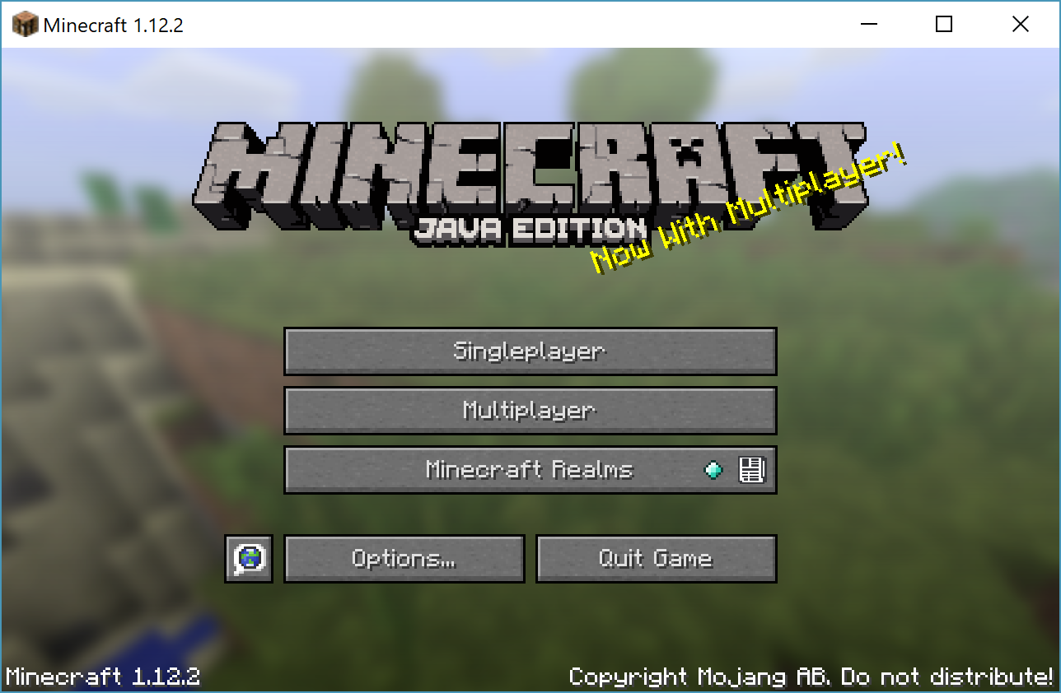


Launch Minecraft

Slide 11
Connect using miner package
In R:
library(devtools)
install_github("ropenscilabs/miner")
install_github("ropenscilabs/craft")
library(miner)
mc_connect("52.170.156.222")
chatPost("Connection Test")
Connections expire after about 10 mins, so reconnect as needed

Slide 12
Modifying the World
library(craft)
v <- getPlayerPos()
write_text("Welcome to" , v+c(0,12,0),
font="8x12", dir="west")
write_text(" SDSS2019" , v+c(0,1,0),
font="8x12", dir="west")

Slide 13
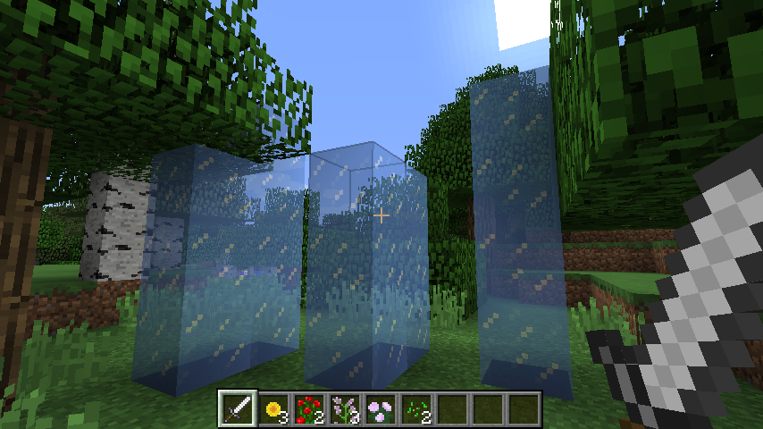
mc_connect()
getPlayerPosition()
setBlocks()
getBlockHits()

Slide 14
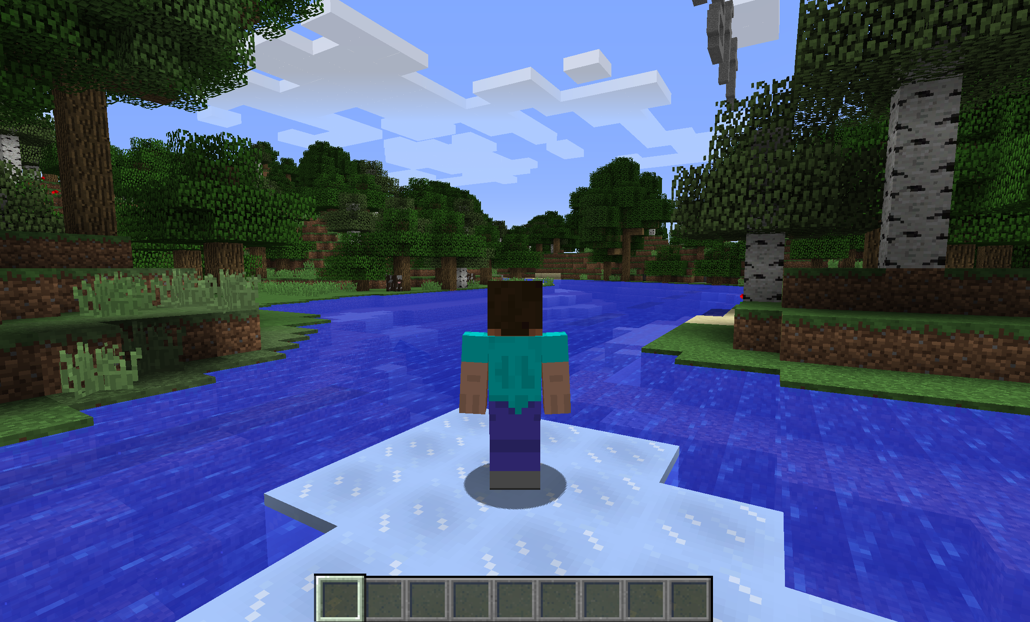
library(craft)
myid <- tail(getPlayerIds(),1)
elsafy(myid)

Slide 15
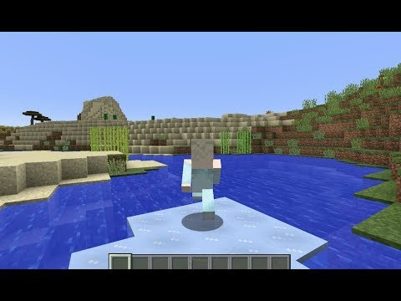
Interacting with players in-game

Slide 16
Interacting with players via chat
Send a message: chatPost()
Players can also chat (press T), which allows us to interact
Get recent messages: getchatPosts()

Slide 17
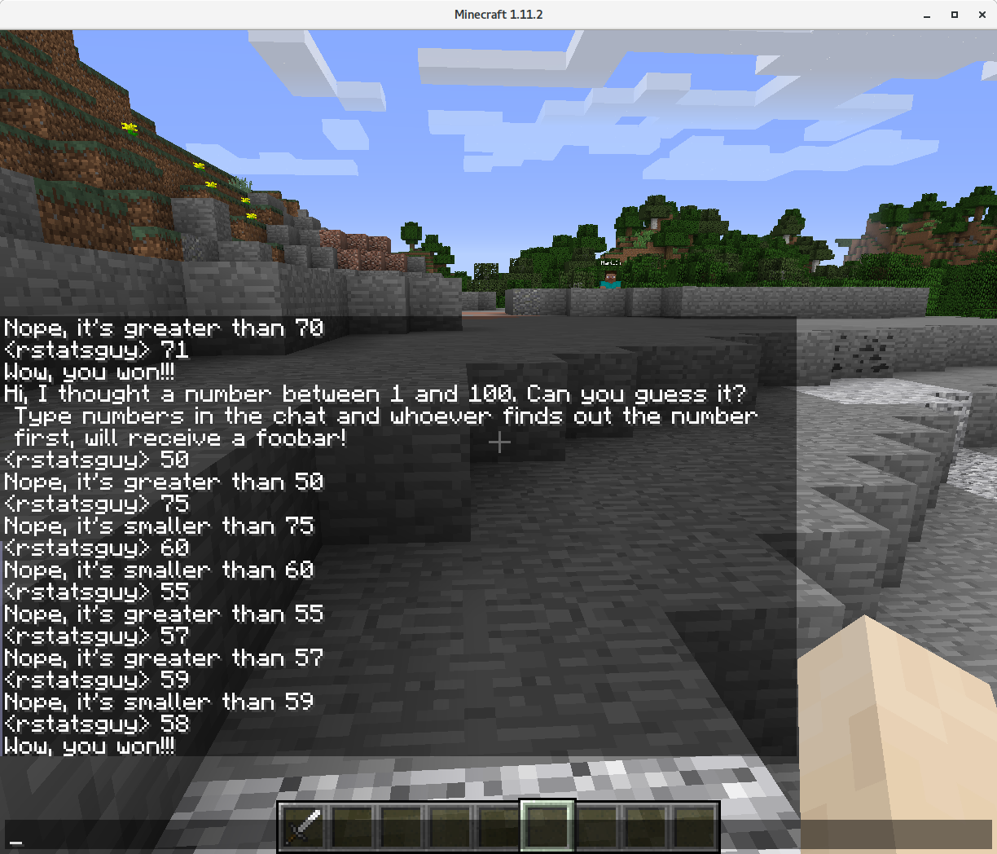
chatPost('Hi, I thought a number between 1 and 100.’)
msg <- getChatPosts()

Slide 18
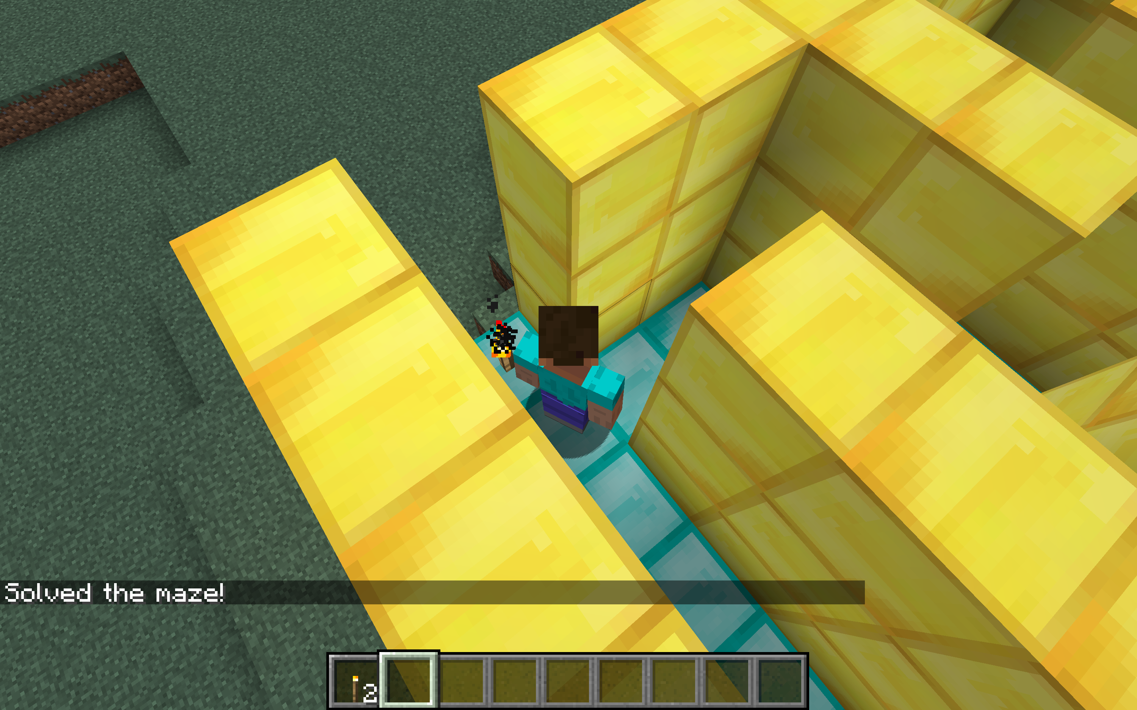
Maze Solving

Slide 19
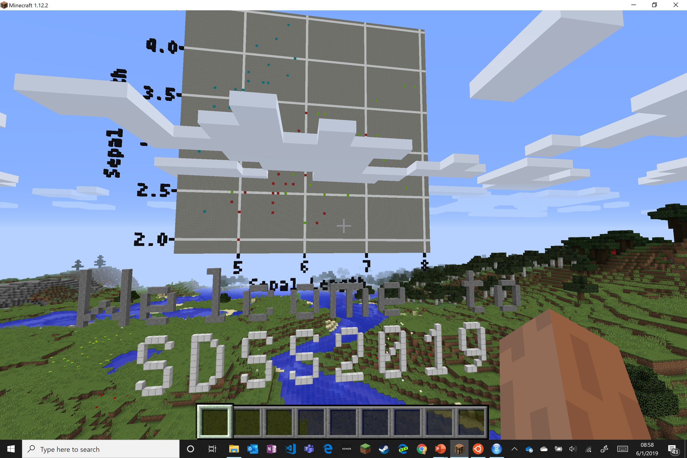
Scatterplots

Slide 20
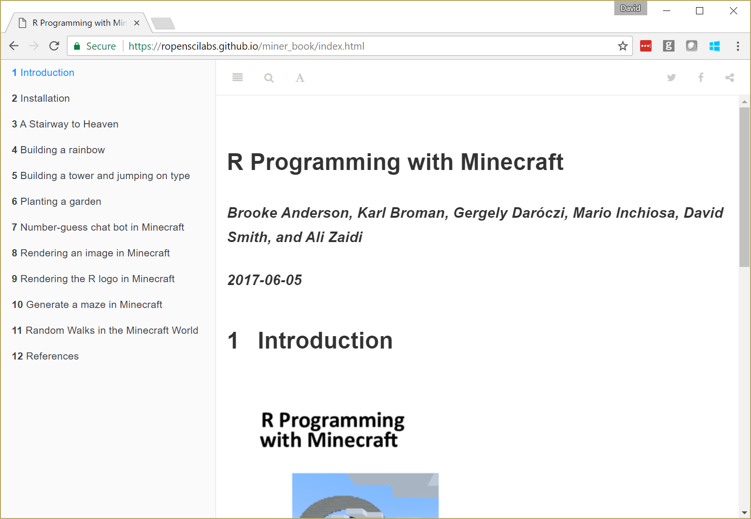

Slide 21
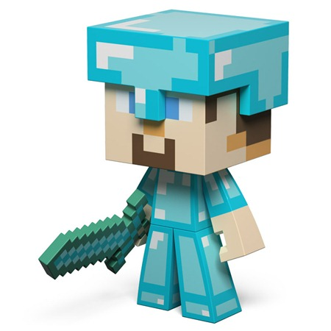
Resources
miner package: github.com/ropenscilabs/miner
“R Programming with Minecraft”: ropenscilabs.github.io/miner_book
Blog posts (search Minecraft):
blog.revolutionanalytics.com
The miner team:
Brooke Anderson
Karl Broman
Gergely Daróczi
Mario Inchiosa
David Smith
Ali Zaidi
Join my server: 13.78.135.40

